Slide 1
Web Development & Python (Not another tutorial)
G Sharmila
Blog: https://www.minvolai.com
Sharmila.gopirajan@gmail.com
Founder:Sitefitnesshq.com

Slide 2
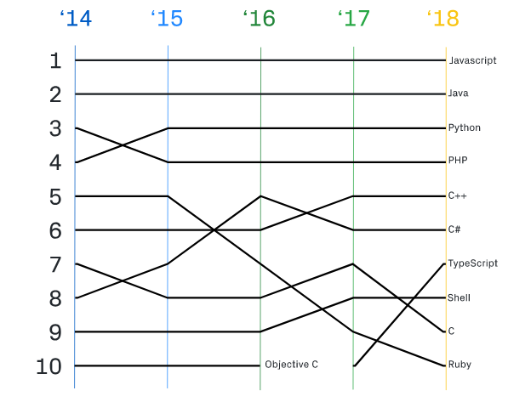
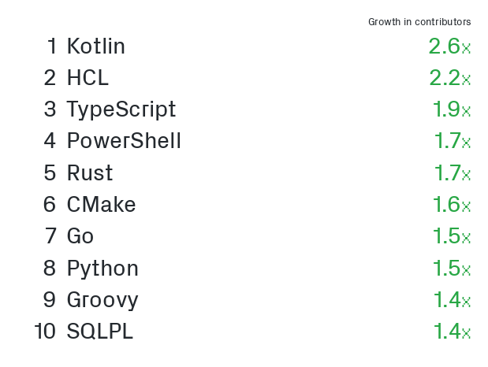
Python The Language

Slide 3
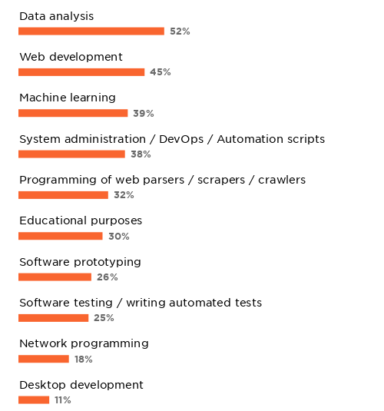
Web Development in Python

Slide 4
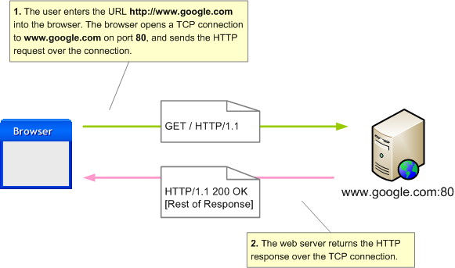
What is a webserver?

Slide 5
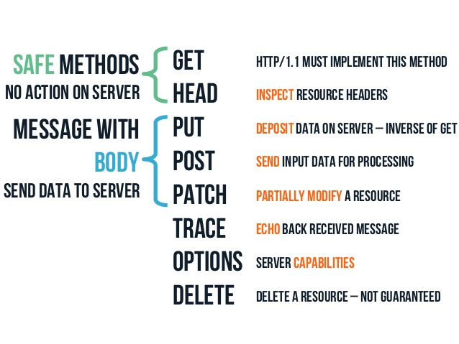
HTTP Protocol

Slide 6
http.server
A simple file server
Standard Library
Extremely simple
Serves files from the directory it is run in
python2 -m SimpleHTTPServer 8000
  or
python3 -m http.server 8000

Slide 7
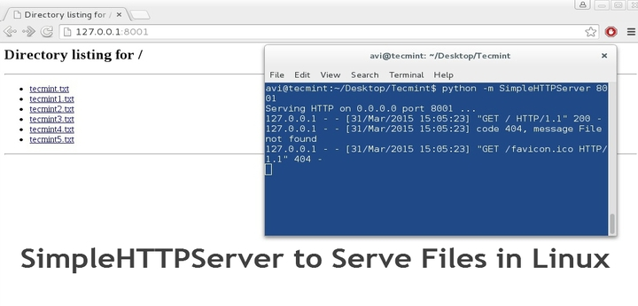
SimpleHTTPServer

Slide 8
Beyond simple file serving - MicroFrameworks
Bottle.py - https://bottlepy.org/docs/dev/
Web2py - http://www.web2py.com/
Flask - http://flask.pocoo.org/

Slide 9
The 3 Main Components
View function – that contains the logic
Templating – embedding python variables/routines in html code
Routing – Routing incoming http requests to the appropriate function, where every path can be represented by a function

Slide 10
Bottle.py
from bottle import route, run, template
@route('/hello/<name>')
def index(name):
return template('<b>Hello {{name}}</b>!', name=name)
run(host='localhost', port=8080)

Slide 11
Flask.py
from flask import Flask
app = Flask(__name__)
@app.route("/hello/<name>")
def hello(name):
return "Hello %s!" %(name)

Slide 12
What flask brings
An awesome templating engine -Jinja2
Werkzeug – routing and basic session and cookie management

Slide 13
Database Management
Flask – Flask-SQLAlchemy
Django – Django ORM
  Version controlled database schema
  No need to remember all the changes you made
  Change models.py
  Run `makemigrations` and `migrate`

Slide 14
Django – Database Management
class Author(models.Model):
"""Model representing an author."""
first_name = models.CharField(max_length=100)
last_name = models.CharField(max_length=100)
date_of_birth = models.DateField(null=True, blank=True)
date_of_death = models.DateField('Died', null=True, blank=True)
class Book(models.Model):
"""Model representing a book (but not a specific copy of a book)."""
title = models.CharField(max_length=200)
author = models.ForeignKey('Author', on_delete=models.SET_NULL, null=True)
summary = models.TextField(max_length=1000, help_text='Enter a brief description of the book')
isbn = models.CharField('ISBN', max_length=13, help_text='13 Character <a href="https://www.isbn-international.org/content/what-isbn">ISBN number</a>')
genre = models.ManyToManyField(Genre, help_text='Select a genre for this book')

Slide 15
Django Database Management
python manage.py makemigrations
  ... generates a python file app/migrations/0001_timestamp.py
python manage.py migrate
... makes the changes to the db
python manage.py migrate my_app <name_of_last_needed_migrate_file>
  Reverts all changes made since <name_of_last_needed_migrate_file>
python manage.py migrate my_app zero
- Revert all

Slide 16
Power of templates
# base_generic.html
<!DOCTYPE html>
<html lang="en">
<head>
{% block title %}<title>Local Library</title>{% endblock %}
</head>
<body>
{% block sidebar %}{% endblock %}
{% block content %}{% endblock %}
</body>
</html>
# index.html
{% extends "base_generic.html" %}
{% block content %}
<h1>Local Library Home</h1>
<p>Welcome to LocalLibrary, a website developed by <em>Mozilla Developer Network</em>!</p>
{% endblock %}

Slide 17
User Management
Flask – flask-login
Django – builtin auth
  Django all-auth

Slide 18
Form Management
Automatic HTML Form creation from Model Definition
Form Validation
Flask – WTForms
Django – Built in

Slide 19
Security
Password Encryption
Cross site scripting (XSS) protection
Cross site request forgery (CSRF) protection
SQL injection protection
Clickjacking protection¶
SSL/HTTPS
Host Validation

Slide 20
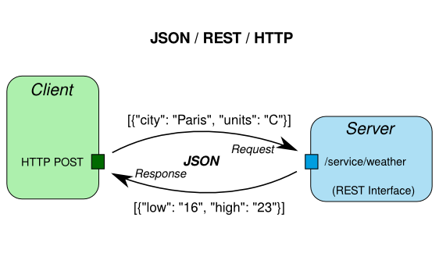
Rest Framework

Slide 21
Other Django Features
Localization
Integrations with AWS (for storage, emailing)
Asynchronous Processing with Celery
Integrations with MailChimp and other SaaS third party providers

Slide 22
Contributing to Open Source - Why
Obviously, Looks good on your resume
Experience
  Tech
  Coding Practices
  Soft Skills
  Project Size

Slide 23
Contributing to Open Source - How
Bug triaging can help core contributors save a lot of time. For example, many new bugs filed are either duplicates or are fixed already.
Community Building
  Bringing in new contributors to replace older contributors when they move on
  Increasing diversity in the group of contributors
Improving documentation
Supporting new users in different communities – Stackoverflow, reddit, irc, slack, mailing lists etc
Helping with Funding

Slide 24
Beginner Friendly Options
Mozilla
  Web Development https://wiki.mozilla.org/Webdev/GetInvolved
  DXR – Code Search and Navigation tool https://wiki.mozilla.org/DXR
  More .. https://whatcanidoformozilla.org/#!/progornoprog/proglang/py/web-development
Django - https://code.djangoproject.com/query?status=!closed&easy=1

Slide 25
Bottle Resources
http://pwp.stevecassidy.net/ - Python Web Programming
  By Steve Cassidy, Department of Computing, Macquarie University, Australia

Slide 26
Thank you!

Slide 27
Django Resources
https://developer.mozilla.org/en-US/docs/Learn/Server-side/Django
https://overiq.com/django-1-10/intro-to-django/
https://simpleisbetterthancomplex.com/series/beginners-guide/1.11/

